Slide 1


Slide 2
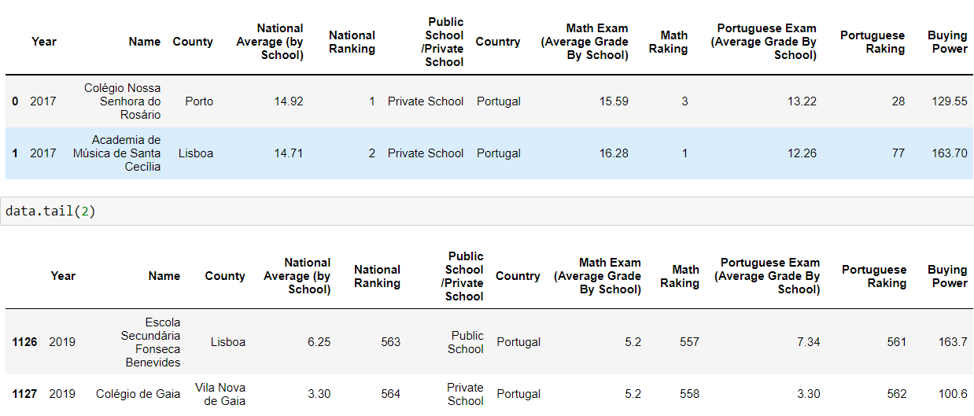
Investment in education begins in pre-school and ends in higher education, but goes through this essential stage of life, which is primary and secondary education. It is critical and fundamental that in these 12 years of schooling we can make a great effort to invest in the generation that will ensure the country of innovation.", António Costa, Prime Minister of Portugal in Diário de Notícias, 07 March 2018
"The current generation is the most qualified ever.", António Costa, Prime Minister of Portugal in Jornal Económico, 06 Septermber 2021
Source: Jornal Público online – Ranking of Schools according with the Average of National Exams (12th Grade) – Years 2017 and 2019 – 564 schools

Slide 3

MATCHED PAIR TEST
H0: Average (National Exams2017) = Average (National Exams2019)
H1: Average (National Exams2017) <> Average (National Exams2019)
i) p_value < alpha

Slide 4
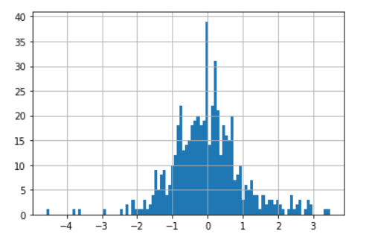
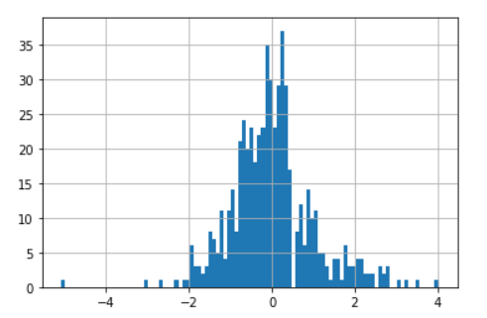
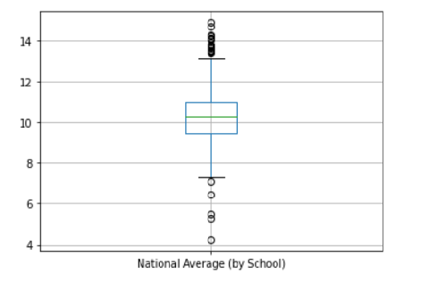
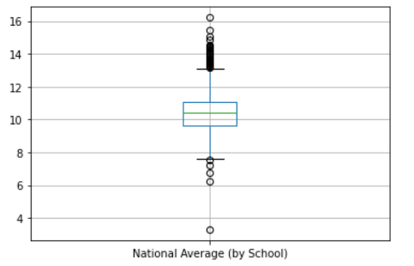
Nevertheless, I Was curious!
2017 – Histogram (100 bins)
2019 - Histogram (100 bins)
Standartize National Averages by school
Standartize National Averages by school
2017 - BoxPlot
2019 - BoxPlot

Slide 5
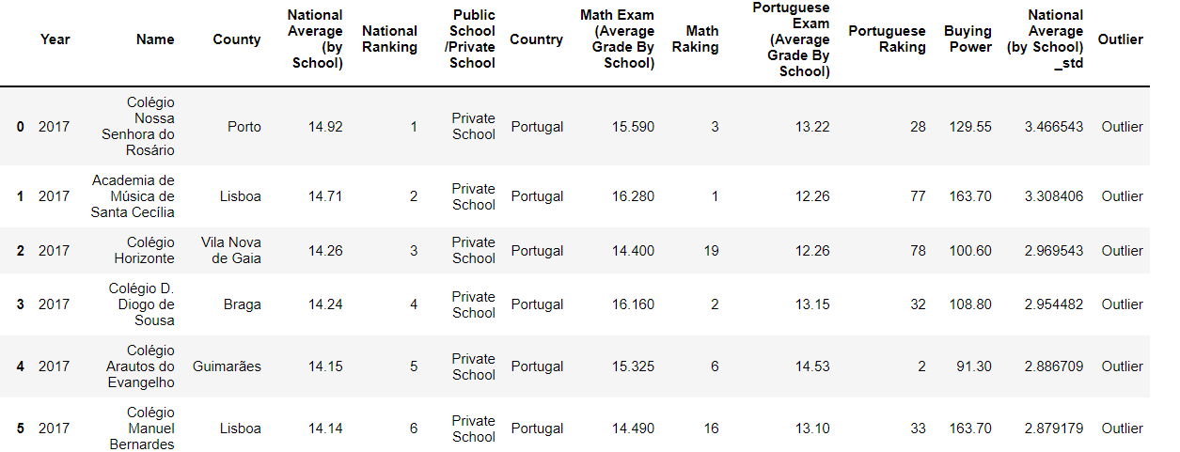
Year 2017 - 24 Outliers – 19 High Outliers (Private Schools) / 5 Low Outliers (3 Private Schools and 2 Public Schoosl)

Slide 6
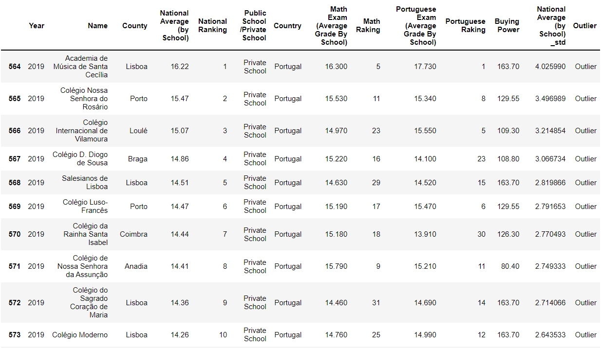
Year 2019 - 36 Outliers – 5 Low Outliers (1 Private School & 4 Public Schools ) – 31 High Outliers (All Private Schools)

Slide 7

INDEPENDENT SAMPLES TEST
H0: Average (National Exams2019-Private Schools) <= Average (National Exams2019-Public Schoos)
H1: Average (National Exams2019-Private Schools) > Average (National Exams2019-Public Schoos)
i) stat>0
ii) p_value < alpha
Note: A one tailed test has a p-value that is half of the two tailed p-value

Slide 8

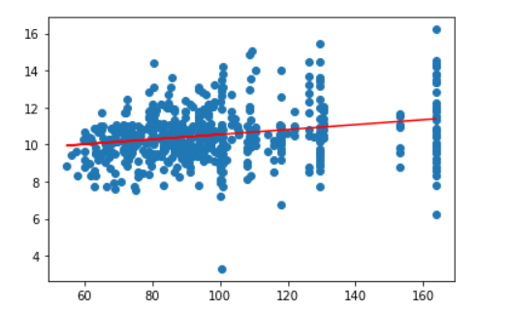
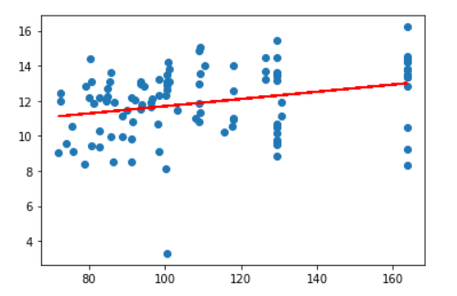
CAN WE ASSUME THAT IF WE HAVE BUYING POWER TO GO TO A PRIVATE SCHOOL, THAT MIGHT BE AN ADVANTAGE / SOLUTION?
Linear Regression: Buying Power vs Nationat Average (by School)
Linear Regression: Buying Power vs Nationat Average (by School) – Private School
Regression line: y = 9.23 + 0.1320712 x
R^2 = 0.06
Regression line: y = 9.639 + 0.0205542 x
R^2 = 0.08

Slide 9
THANKS!

